Slide 1
Are YOU leading the life you want to?
Allison Hursman, PharmD, BCGP
Population Health Pharmacist
Essentia Health
Elizabeth Monson, PharmD, BCPS
Assistant Professor of
Pharmacy Practice
North Dakota State University
Essentia Health

Slide 2
Disclosures
Allison Hursman and Elizabeth Monson have no financial relationships with ineligible companies to disclose

Slide 3
Objectives
Recognize inequities between genders in the workplace.
Upon successful completion of this course, pharmacists and pharmacy technicians should be able to:
Describe how to prioritize one’s voluntary workload.
Quantify the “Ask Score” and “Giving Score.”
Discuss the benefits of amplifying voices within the workplace.
Apply strategies to achieve professional goals via patient cases.

Slide 4
Ice Breaker: Interview
Think about the interactions that you’ve had at convention so far
What sort of questions have you been asking others?
Example Interaction
Notes:
How are you?
How are things at NDSU going?
Have you been enjoying convention?
Remind me again what ages are your kids?
Who’s watching your kids this weekend?
How does your wife handle being home with all 3 kids at once when you’re gone? Does she have other people come to help her?
Is it hard for your to leave your kids for the weekend?
It sounds like you have a lot going on at NDSU. I know that you’ve got some big research projects going on and you’re involved with ASHP on a national level. How do you find time to balance this and still show up for your family?
You’re so busy – do you ever see your kids??
Aren’t you worried on missing out?

Slide 5
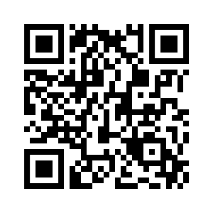
Pause and Reflect
How did this activity make you feel?
How often have you been asked similar questions?
How are expectations different for males vs females?
Notes:
How did this interview make you feel.
Poll – Females – how many times have you been asked these sorts of questions this weekend?
Males – similar?

Slide 6
Expectations of Females
Personality traits
Empathy, nurturing, kindness
Domestic behaviors
Childcare, cooking, cleaning
Occupational expectations
Expectations of Males
Personality traits
Self-confident, ambitious, tough
Domestic behaviors
Finances, home repairs, automotive
Occupational expectations
Gender Identity & Roles | Feminine Traits & Stereotypes. Accessed February 16, 2023. https://www.plannedparenthood.org/learn/gender-identity/sex-gender-identity/what-are-gender-roles-and-stereotypes

Slide 7
Helping others and filling in
Non-promotable tasks
Organizing and coordinating the work of others
Diffusing angry/upset patients or coworkers
Logistical planning and special events
Committees, committees, committees
Resolving conflict among coworkers
A non-promotable task (NPT) matters to the organization but will not help your career.
Helping coworkers with their personal problems
Onboarding, training, and mentoring
Office housework
The No Club: Putting a Stop to Women’s Dead-End Work.; 2022. Accessed February 16, 2023. https://www.youtube.com/watch?v=Ya5cjo7bGC8
Notes:
Helping when someone is absent, reviewing work, etc – when you’re good at your job, you get to do everyone else’s too.
Office housework – cleaning, watering plants, ordering food, picking up food, meds, fixing printers, sinks, etc.
Committees – more applicable in the hospital setting
Logistical planning – going away parties, etc
Organizing – scheduling (if not part of job descriptions) – APPE schedule, intern schedule etc.
Helping others/filling in – snow days; working outside of your assigned role that day

Slide 8
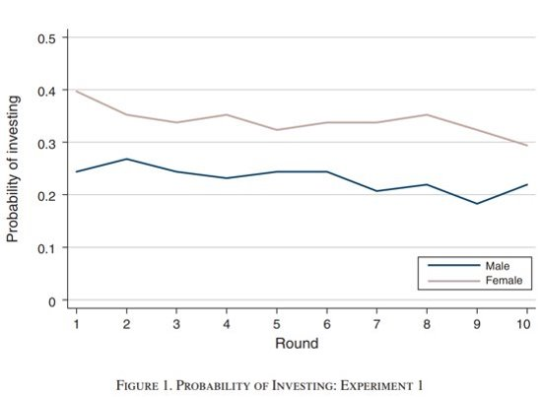
Take one for the team
Task that everyone wanted done, but preferred someone else to do
Mixed gender group:
Women 48% more likely to volunteer
Women 49% more likely to say yes when asked
Women 44% more likely to be asked
Babcock L, Recalde MP, Vesterlund L, Weingart L. Gender Differences in Accepting and Receiving Requests for Tasks with Low Promotability. American Economic Review. 2017;107(3):714-747. doi:10.1257/aer.20141734
Notes:
In a series of experiments6, we studied who agrees to ‘take one for the team’ and handle a task that everyone wanted to be done but preferred someone else to do. In mixed-gender groups, we found that women were 48% more likely to volunteer to do the task, 49% more likely to say yes when asked directly to do it and 44% more likely to be asked to do the task. The underlying reason is simple, and sad: we all expect women to take on this work, which is why we ask them more often and judge them harshly when they say no. Women have internalized these expectations, and they feel a lot of pressure to say yes.
BECAUSE WE ARE EXPECTED TO!
For example, women may be more likely than men to agree to requests to perform non-promotable tasks if they are more other-regarding and more concerned for the welfare of, if they are more agreeable and have a greater desire to be liked by the requestor, if they have a greater desire to conform to a norm of accepting such requests, if they are more risk averse, and more concerned about the consequences from declining the request

Slide 9
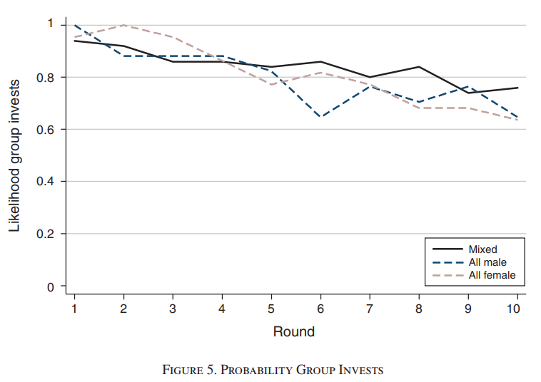
Take one for the team
Task that everyone wanted done, but preferred someone else to do
Same gender groups:
Results were similar
In almost every round, the female group invested more often than the male group
Babcock L, Recalde MP, Vesterlund L, Weingart L. Gender Differences in Accepting and Receiving Requests for Tasks with Low Promotability. American Economic Review. 2017;107(3):714-747. doi:10.1257/aer.20141734
Notes:
Interestingly, the gender gap in volunteering is eliminated when participants know that they are paired only with members of their own sex. Thus, an individual’s willingness to volunteer is not fixed and responds to the gender composition of the group. We interpret the differential response to the single-sex environment as evidence that the gender gap documented in Experiment 1 is not driven by preferences but rather by the belief that women are more likely than men to volunteer

Slide 10
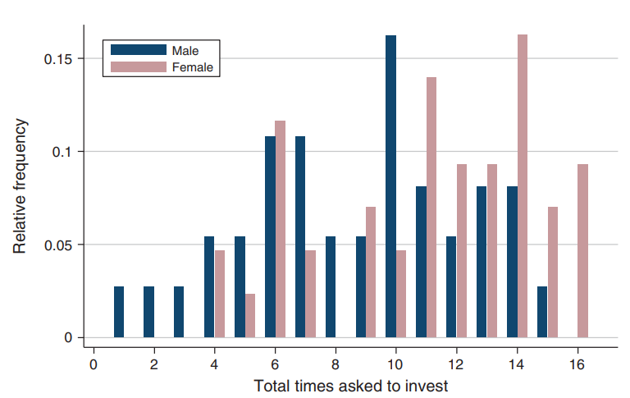
Take one for the team
Task that everyone wanted done, but preferred someone else to do
Requestor added:
Women are asked more by both men and women
Requests increase the likelihood that someone will volunteer despite gender
Increase in volunteering in women is larger
Babcock L, Recalde MP, Vesterlund L, Weingart L. Gender Differences in Accepting and Receiving Requests for Tasks with Low Promotability. American Economic Review. 2017;107(3):714-747. doi:10.1257/aer.20141734
Notes:
Modifying our design to add a requestor who can ask one other participant to volunteer, we show that women are asked to volunteer more than men, and that women are asked more by both men and women. The difference in requests is consistent with the belief that women more than men accept such requests. Confirming the role of beliefs we find that women respond more favorably to these directed requests than do men. While requests increase volunteering for both men and women, the increase for women is substantially larger.

Slide 11
What does this mean?
Greater time spent on NPTs
Work Overload
Career stagnation
Diminished personal identity
Emotional exhaustion
Tension with coworkers
Job dissatisfaction, stress and turnover
Negatively impacts work/family balance
Social isolation
Psychological and physical stress
Career stagnation
The No Club: Putting a Stop to Women’s Dead-End Work.; 2022. Accessed February 16, 2023. https://www.youtube.com/watch?v=Ya5cjo7bGC8
Notes:
Bad for organizations as a whole

Slide 12
Action Steps
Different expectations
We ask females different questions because the societal expectations for females are different
What can we do to reduce our workload?
How do we prioritize?
Can we still be a team player?
Do you ask for help?
What’s your ask score vs your give score?
Amplify Voices
How do you build up females?

Slide 13
What can we do to combat this?
Suggestions from "The No Club"
Resist the urge to immediately say yes or volunteer
Say no... without negative repercussions
Say yes to the right things
The No Club: Putting a Stop to Women’s Dead-End Work.; 2022. Accessed February 16, 2023. https://www.youtube.com/watch?v=Ya5cjo7bGC8
Babcock L, Peyser B, Vesterlund L, Weingart L. The No Club: Putting a Stop to Women’s Dead-End Work. Simon and Schuster; 2022.
Notes:
HELL YES
Things that fulfill you
Leverage your expertise
Provide a godo return on your time spent
Give you a mental break
Fit with your current assignments

Slide 14
Resist the urge to say yes immediately
Get the information that you need to understand the task
Consider who is asking you?
Ignore the ‘DIVA’ moment.
What kind of influence do they have?
“I can’t believe they chose me – I HAVE to say yes”
How much time will it take?
Notes:
Pause before you say yes – give yourself time to consider the investment of your time – Let me think about it
Get the info that you need to understand the task – how much time will it take
Consider who is asking you
Ignore the diva moment
Remember the future you – likely to have just as full of a calendar

Slide 15
Gracefully bow out
Offer an alternative to solve the problem
Put conditions on your yes
Do a B+ job rather than an A+ job
Ex: Ask for additional resources or to give up something else
It doesn’t have to be perfect, it just has to be something
Ex: Recommend someone else
Notes:
Saying no
Offer alternative to solve the problem
Put conditions on your yes
Consider asking for additional resources
Do a B+ rather than and A+job

Slide 16
Finding the right Yes
Consider the following:
Things that fulfill you
Provide a good return on your time spent
Give you a mental break
Leverage your expertise
Fit with your current assignments
Notes:
HELL YES
Things that fulfill you
Leverage your expertise
Provide a godo return on your time spent
Give you a mental break
Fit with your current assignments

Slide 17
Action Steps
Different expectations
We ask females different questions because the societal expectations for females are different
What can we do to reduce our workload?
How do we prioritize?
Can we still be a team player?
Do you ask for help?
What’s your ask score vs your give score?
Amplify Voices
How do you build up females?

Slide 18
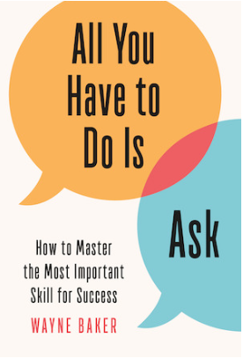
What is your "Ask Score" and "Giving Score" ?
Take a moment to think about the following:
How often do you ASK for help?
HOW do you ask for help?
How often do you PROVIDE help?
Visualize the people who will turn to you for solutions.
Notes:
Imagine you’re on a deadline for a big project, and feeling overwhelmed. Or you’re looking for a new job, but can’t seem to get your foot in the door. Or you’re facing a personal challenge, and just don’t know what to do. What do these problems have in common? They can all be solved simply by reaching out to a colleague, friend, acquaintance, or wider network and making an ask. Studies show that asking for help makes us better and less frustrated at our jobs. It helps us find new opportunities and new talent. It unlocks new ideas and solutions, and enhances team performance. And it helps us get the things we need outside the workplace as well. And yet, we rarely give ourselves permission to ask. Luckily, the research shows that asking—and getting—what we need is much easier than we think.
When you ask for help are you successful in receiving it? Do you make a SMART request or is it vague? We often think of the phrase SMART for setting goals, but really it could be used in your requests. Specific, Meaningful, Action, Realistic, Time
Do you provide help equal to the help your colleages provide? They both matter right? You're more likely to get help from someone if you are seen as a helper. Even if you have never helped the individual you are asking. That's why networks are important. If it is known that you are a helper someone may feel compelled to help you just for that reason.

Slide 19
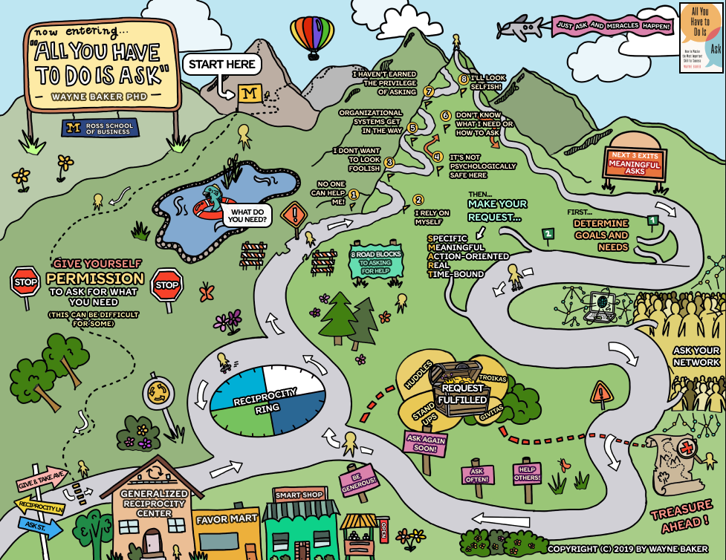
Ask/Help Guide
What are your roadblocks to asking for help?
Permission to use infographic from: The 'All You Have to Do Is Ask' Journey | Infographic — 'All You Have To Do Is Ask'
Notes:
Do any of these phrases sound familiar: "No one can help me, I rely on myself, I don't want to look foolish, It's not psychologically safe here, organizational systems get in the way, don't know what I need or how to ask, I haven't earned the privilege of asking, I'll look selfish" ?
Steps: 1) Determine goals and needs 2) Make your request: SMART, Ask Your network 3) Request is fulfilled
Help Others, Ask Often, Ask Again Soon, Be Generous!

Slide 20
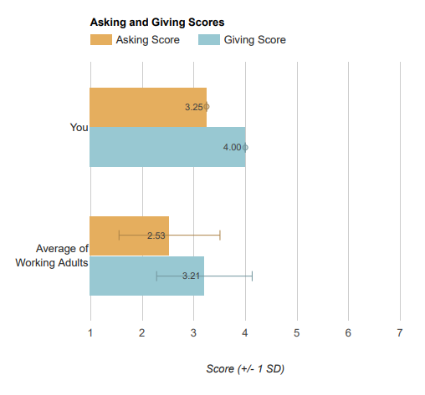
Asking-Giving Assessment
Eizabeth's Scores
Allison's Scores
Online Survey Software | Qualtrics Survey Solutions
Notes:
Compared to hundreds of working adults who represented a wide variety of roles and industries. Only 10% of these working adults could be classified as Giver-Requesters, with both Asking and Giving scores greater than 4.
** This took Allison 2 minutes to complete. Threw in a small picture of my answers in case you wanted to showcase a true under asker. :l OR add it after slide 14... and I'm happy to start the conversation if needed.
QR Code – added - do you want to have them do it here or on slide 14 – move as needed

Slide 21
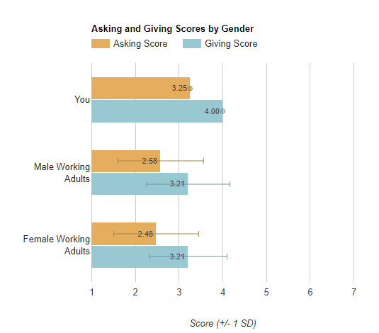
Asking-Giving Assessment
Comparison Groups
Online Survey Software | Qualtrics Survey Solutions
Notes:
Compared to hundreds of working adults who represented a wide variety of roles and industries. Only 10% of these working adults could be classified as Giver-Requesters, with both Asking and Giving scores greater than 4.
This surprised me....

Slide 22
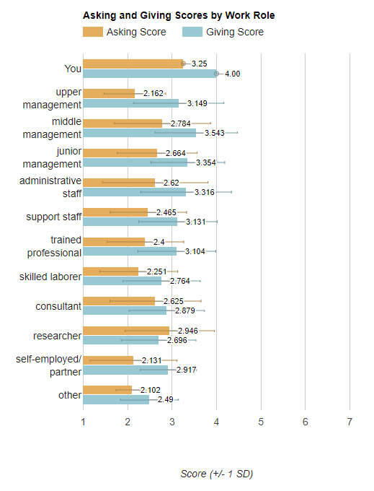
Asking-Giving Assessment
Comparison Groups
Online Survey Software | Qualtrics Survey Solutions
Notes:
Compared to hundreds of working adults who represented a wide variety of roles and industries. Only 10% of these working adults could be classified as Giver-Requesters, with both Asking and Giving scores greater than 4.

Slide 23
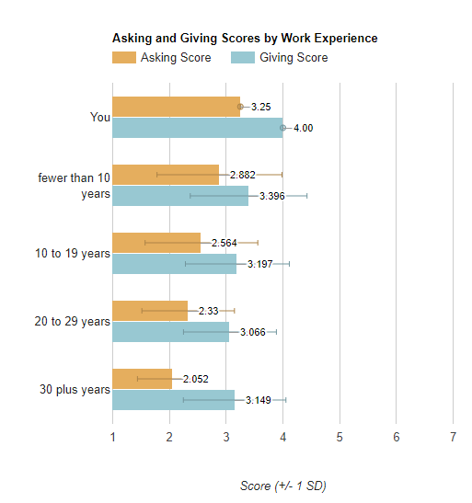
Asking-Giving Assessment
Comparison Groups
Online Survey Software | Qualtrics Survey Solutions
Notes:
Compared to hundreds of working adults who represented a wide variety of roles and industries. Only 10% of these working adults could be classified as Giver-Requesters, with both Asking and Giving scores greater than 4.

Slide 24
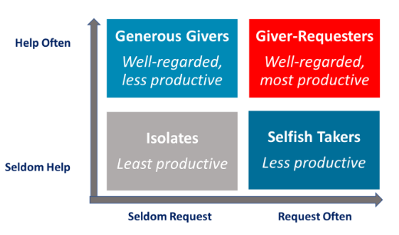
Asking-Giving Assessment
Asking-to-Giving Ratio: 0.81
Online Survey Software | Qualtrics Survey Solutions
Notes:
Compared to hundreds of working adults who represented a wide variety of roles and industries. Only 10% of these working adults could be classified as Giver-Requesters, with both Asking and Giving scores greater than 4.
A ratio below 1 means that you may not be asking as often as you give.
How many of you think you are in the generous giver category? Help others often but seldom request. The goal is to be a giver-requester.

Slide 25
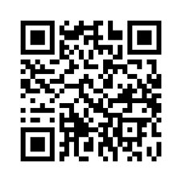
1.
Asking-Giving
Assessment
Complete your self-assessment
2.
Your turn:
Discuss with someone next to you
3.
Large group discussion
Online Survey Software | Qualtrics Survey Solutions
Notes:
QR Code
Think, pair, share.....
Questions:
How do you compare?
Are you surprised?
What is one thing you want to start doing differently?

Slide 26
Action Steps
Different expectations
We ask females different questions because the societal expectations for females are different
What can we do to reduce our workload?
How do we prioritize?
Can we still be a team player?
Do you ask for help?
What’s your ask score vs your give score?
Amplify Voices
How do you build up females?

Slide 27
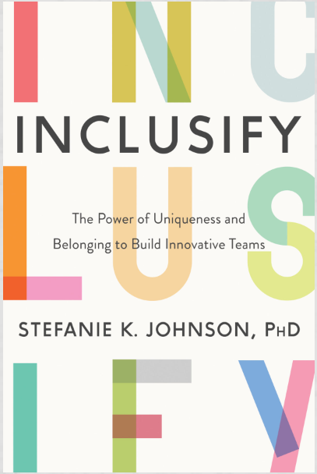
Amplify Others' Voices
Have you ever felt like what you said wasn't heard?
Has your idea ever been repeated by someone else and used as their idea instead of your own?
John says the exact same thing as Linda
Linda says her idea:
Everyone Agrees with John!
Dead Silence
Resolves a common problem.
Everyone tries to find a different idea.
Matt Agrees with John: "What a great idea!"
Linda feels unheard.
Home - Dr. Stefanie K. Johnson (drstefjohnson.com)
Notes:
Example: a scheduling problem, what if xyz

Slide 28
Amplify Others' Voices
What can you do?
Find your allies; Be an Ally.
Step 1
Step 2
Step 3
Use eye contact and listen to what the person said.
Listen to what the other person says.
Use your microphone: Repeat THEIR ideas as their ideas, not yours.
Notes:
Speak out. Use your microphone literaly or figuratively.

Slide 29
LM is a 26 y/o
Case 1
Female pharmacy technician that works for Gold Star Pharmacy.
HPI:
In a touch base meeting with her boss, he asks her if she would be willing to lead a project on vaccinations. "You are always so dependable and you have great organization skills."
LM is one of 10 technicians that work in the pharmacy 5 of whom are female. She is already the technician that always puts in the medication order.
Apply the skills we have learned:
Amplify
Say "no"
Ask for help
What can she do?
Notes:
Technician talking to boss
Meeting scenario
Male/female-position of more power, seniority...

Slide 30
MJ is a 33 y/o
Case 2
Female pharmacist attending a pharmacy department meeting.
HPI:
In the meeting it is noted that some people are not stepping in to verify orders on a regular basis. The pharmacy manager asks if anyone has an idea of how to equally divide the work. MJ speaks up with an idea. Others try to give ideas that just do not seem possible.
Apply the skills we have learned:
Amplify
Say "no"
Ask for help
What can you do?

Slide 31
The No Club: Putting an End to Women's Dead-End Work by Linda Babcock, Brenda Peyser, Lise Versterlund and Laurie Weingart
Resources
https://www.youtube.com/watch?v=Ya5cjo7bGC8
https://podcasts.apple.com/us/podcast/the-no-club-member/id1501859206?i=1000559473555
All You Have to Do Is Ask: How to Master the Most Important Skill for Success by Wayne Baker
https://www.youtube.com/watch?v=qVgKmCEru4A
https://umich.qualtrics.com/jfe/form/SV_d0bVREYSYeeeMyF
Inclusify: The Power of Uniqueness and Belonging to Build Innovative Teams by Stefanie K. Johnson
https://www.youtube.com/watch?v=ii8phQf8E3s

Slide 32
Recognize inequities between genders in the workplace.
Which of the following personality traits is commonly associated with females?
Self confident
Ambitious
Tough
Empathetic
Reflect on one’s voluntary workload and how to strategically determine what to prioritize.
Which of the following is not a consequence of spending more time on Non-Promotable Tasks?
Career stagnation
Enhanced personal identity
Emotional exhaustion
Tension with coworkers
Quantify your “Ask Score” and “Giving Score.”
According to the Ask/Give score, which of the following is the most well-regarded and productive?
Isolator
Selfish Taker
Giver-Requestor
Generous Giver
Discuss the benefits of amplifying voices within the workplace.
True/False: Amplifying voices can only be done by males in the workplace.
False – Amplifying voices is something that can and should be done by everyone, regardless of gender, title, or position.

