Slide 1
NDSU APhA-ASP 2023-2024
Anna Benson, President
Cori Bonik, President-elect
Zoe Schnell, VP Communications & incoming President Elect

Slide 2
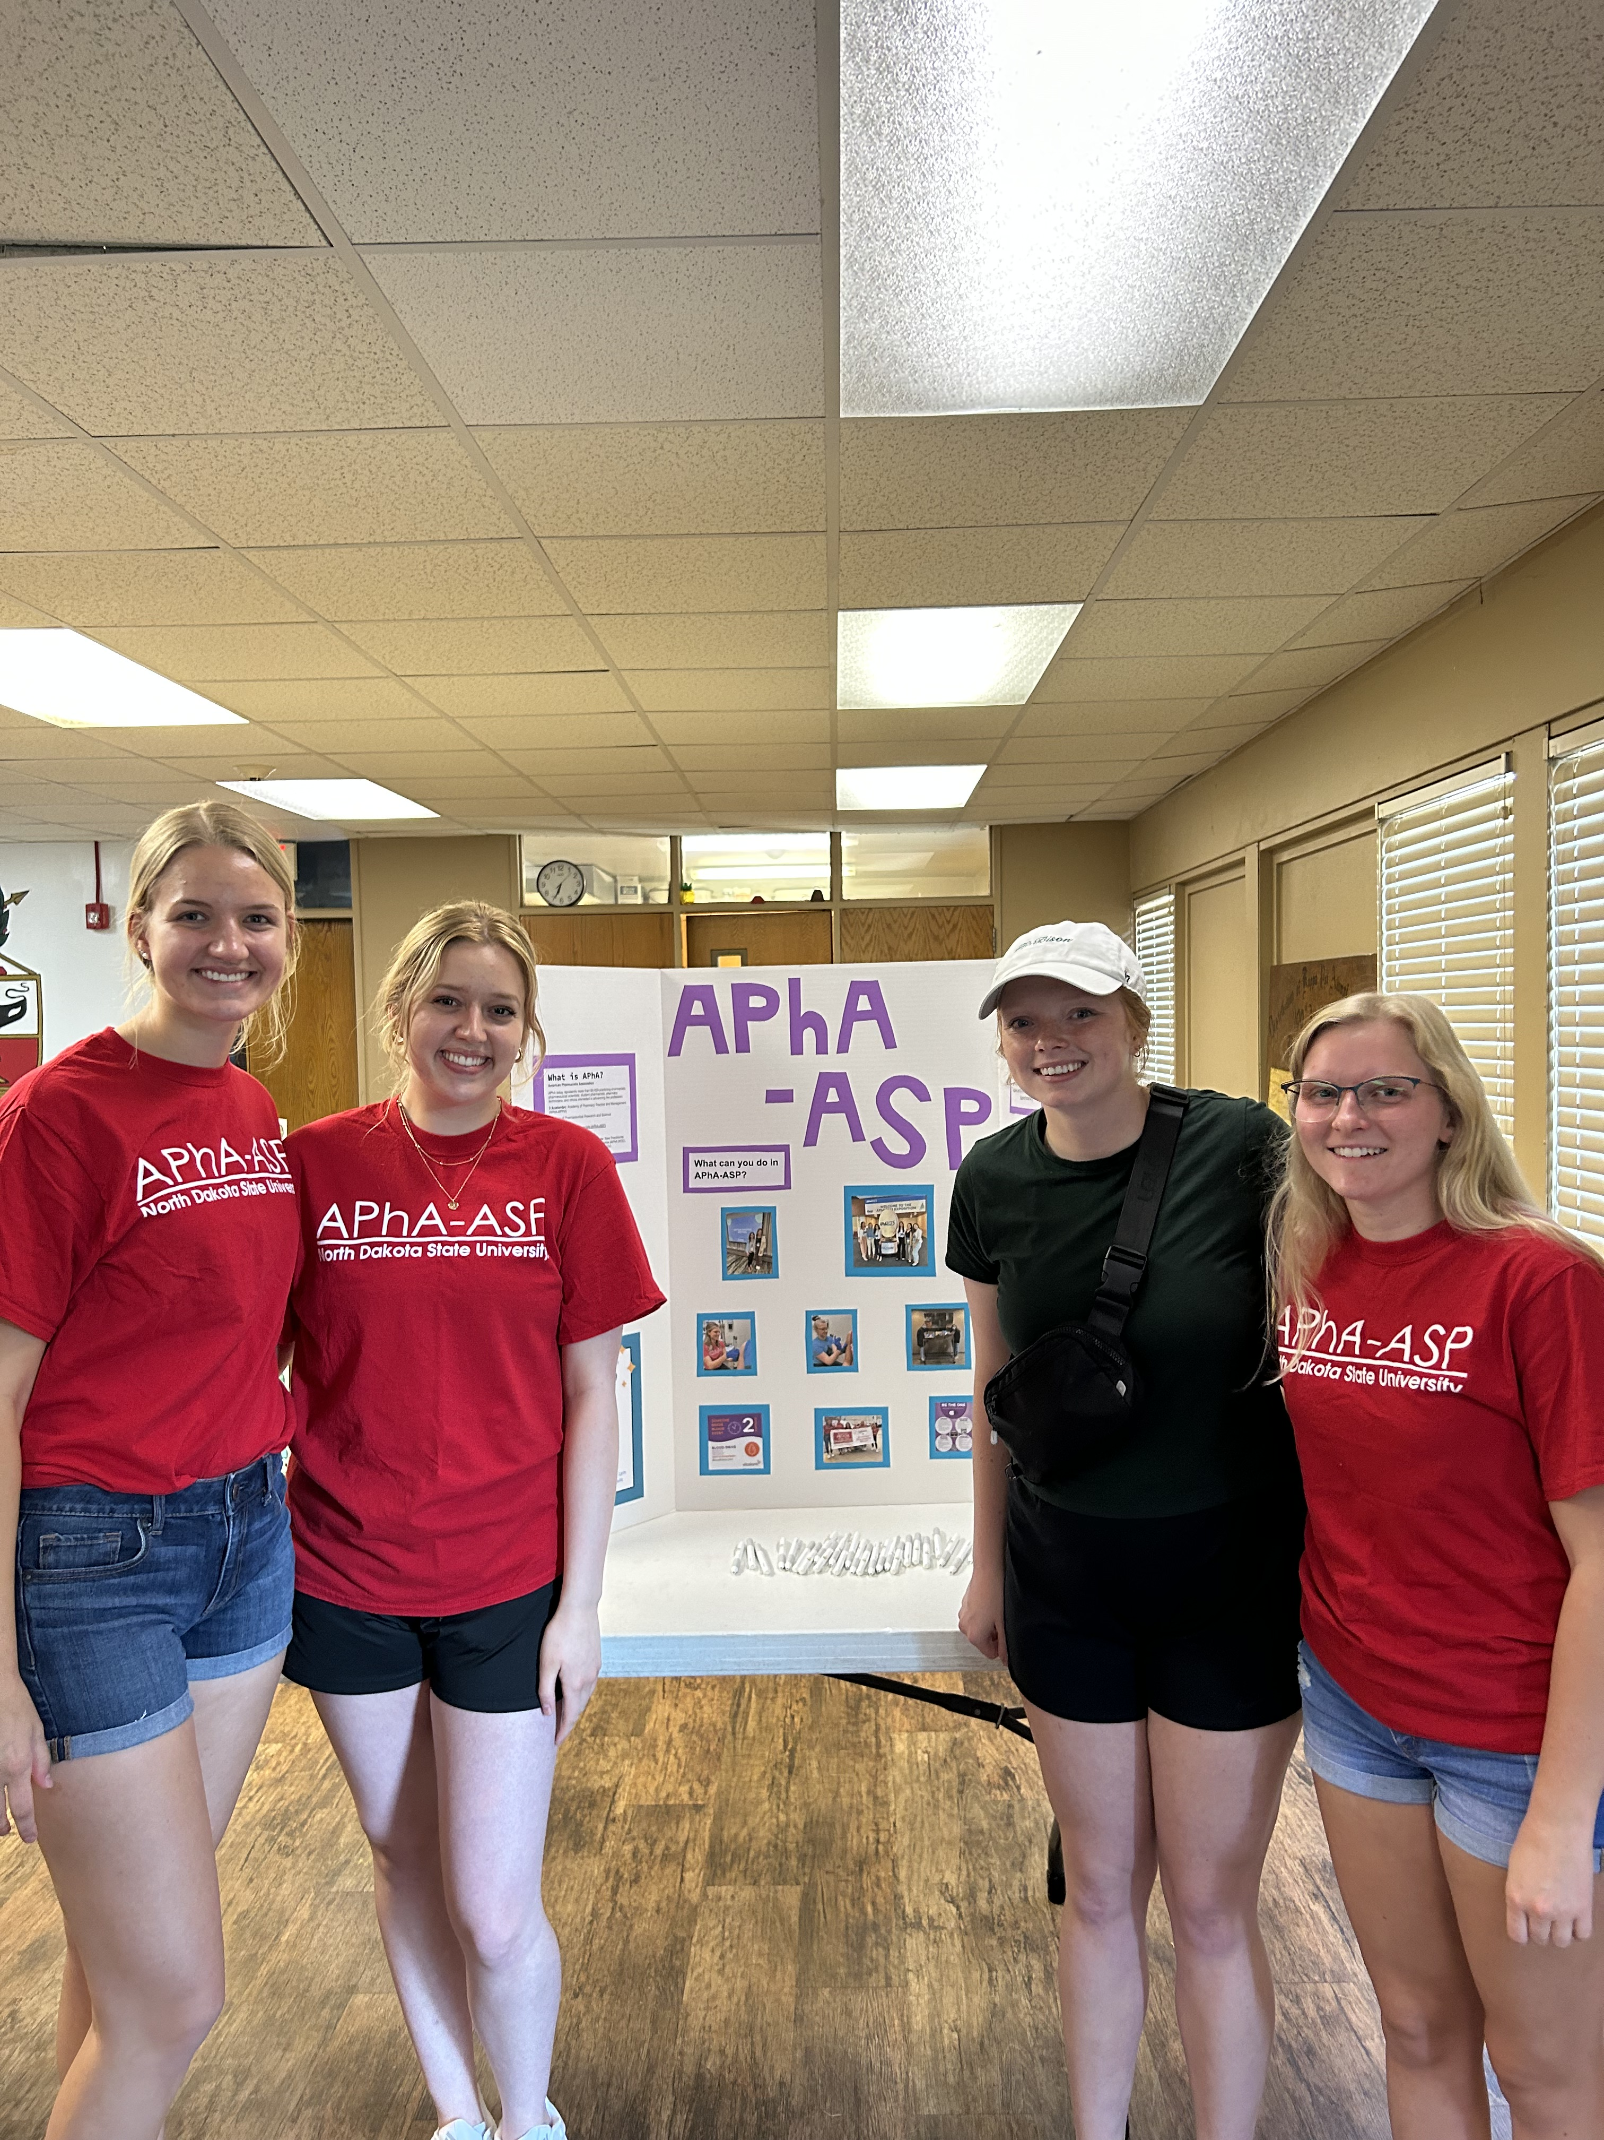
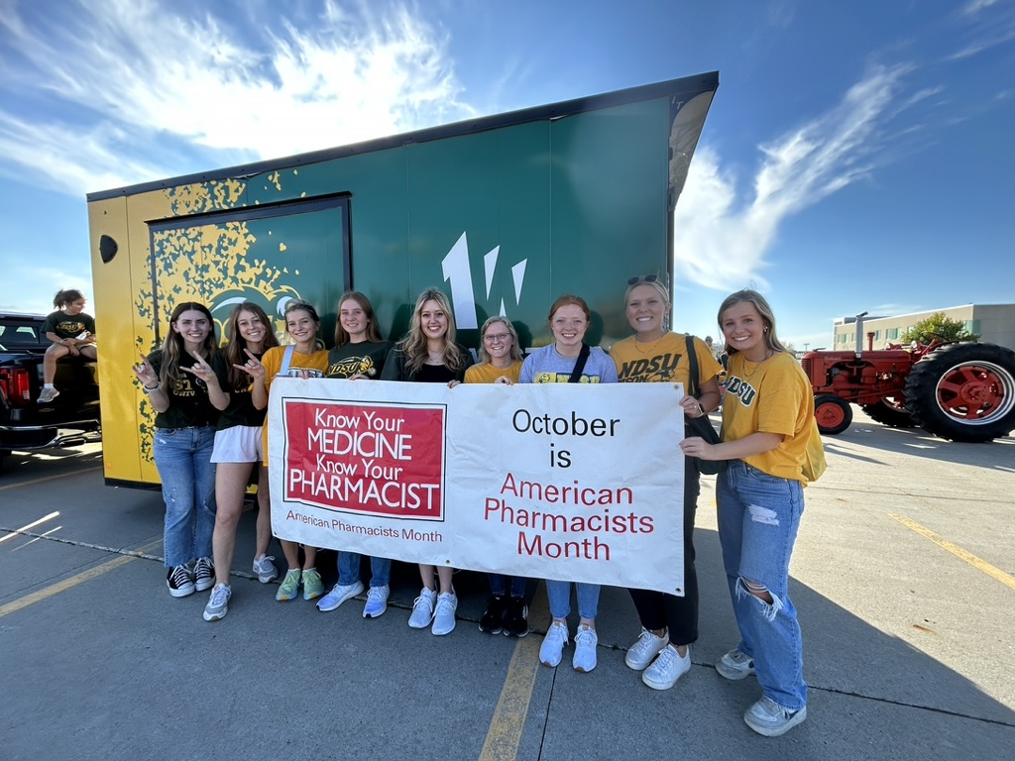
Homecoming Parade and Pharmacy Grill Out
Our members walked in the NDSU Homecoming Parade promoting APhA and the Be the One Program!
We partnered with other pharmacy organizations on campus for a Pharmacy Grill Out to recruit new members to join APhA and bond with fellow pharmacy students

Slide 3
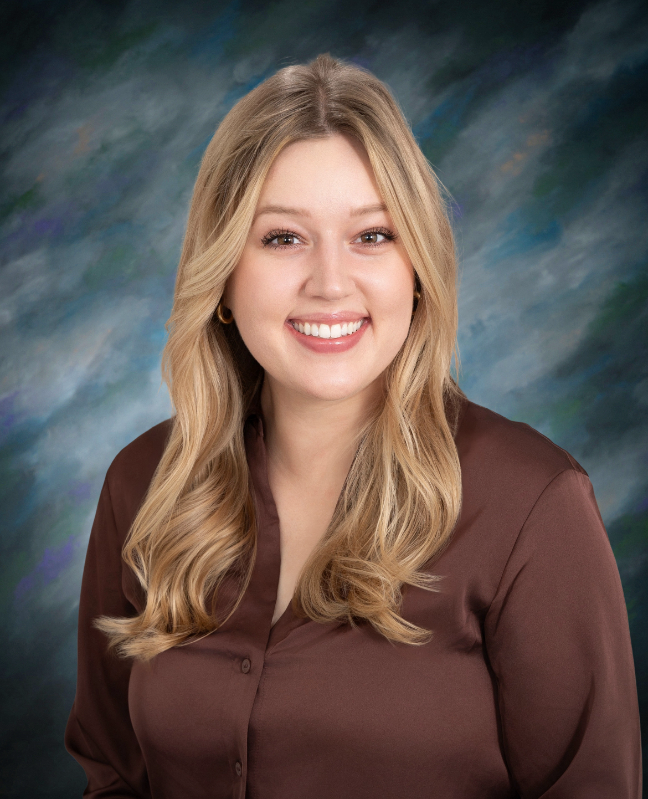
Patient Counseling Competition
We had many pharmacy students participate in our patient counselling competition this year. They competed by counselling a patient actor on a medication and answering any questions the patient had. Our winner this year was Jenna Wilke, and she went on to compete at the Annual Meeting in Orlando!

Slide 4
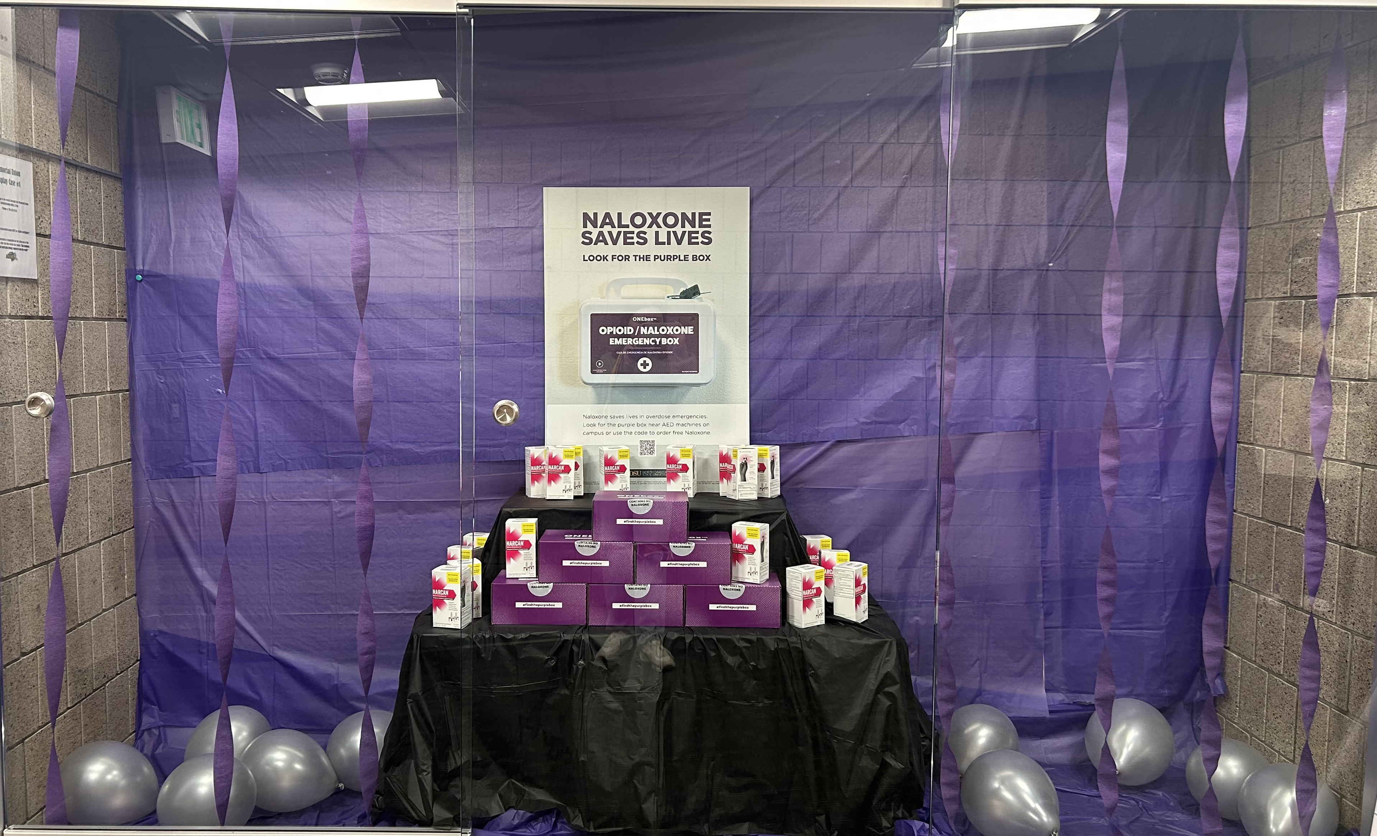
Be the ONE
We had many members continue to be heavily involved in the Be the One Project. Our work in this project won a regional award and was in the running for a national award at Annual!

Slide 5
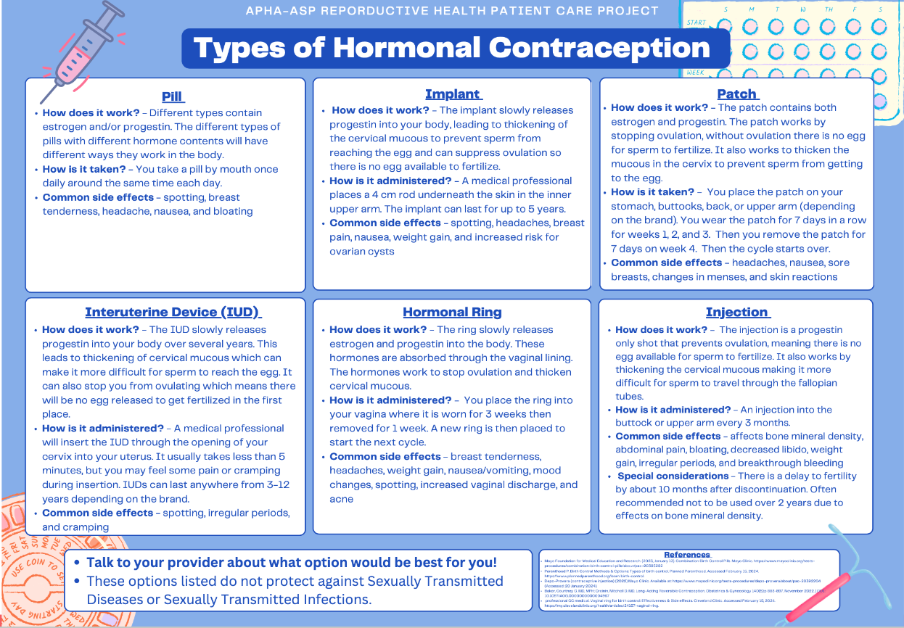
Birth Control Posters
During meetings, our members worked to put together an informational poster on birth control options as a part of Operation Reproductive Health. We were able to hang these posters around campus to provide education to students.

Slide 6
NDSU Powwow POC Testing
Our members are excited to host a POC testing booth at the upcoming Powwow at NDSU on May 4th. We will be screening for diabetes and high cholesterol.

Slide 7
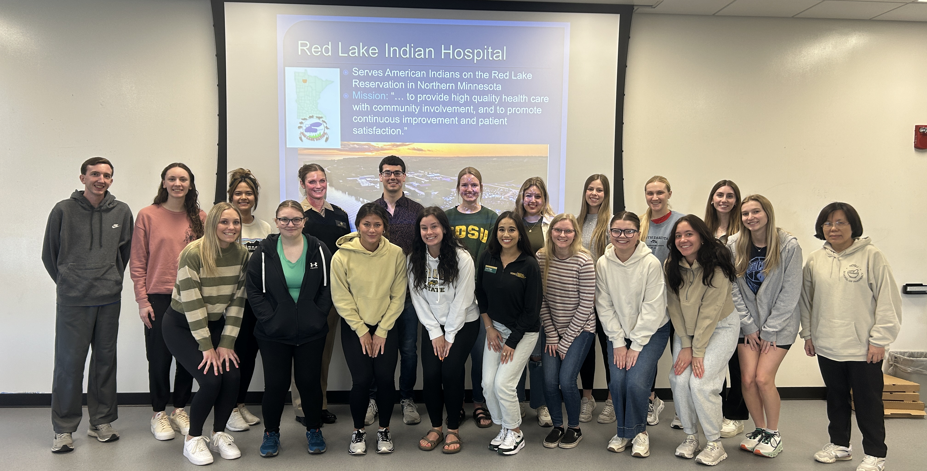
IHS Speaker
We were fortunate to have Dr. Ethan Ryberg and Dr. Samantha Gustafson from Red Lake IHS come speak to our members about working in IHS.

Slide 8
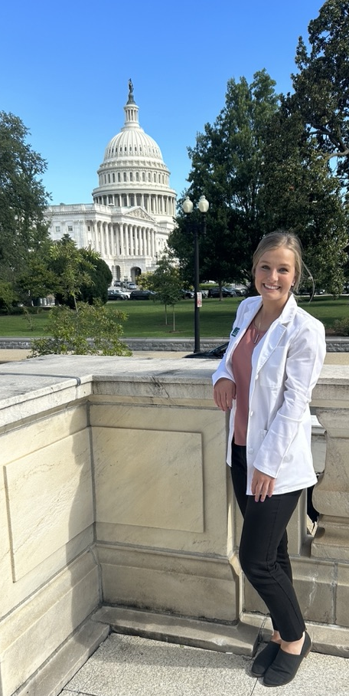
Summer Leadership Institute
President-elect, Cori Bonik attended the APhA Summer Leadership institute in Washington D.C. in July. She was able to learn more about APhA and visit capitol hill to advocate for provider status for pharmacists!

Slide 9
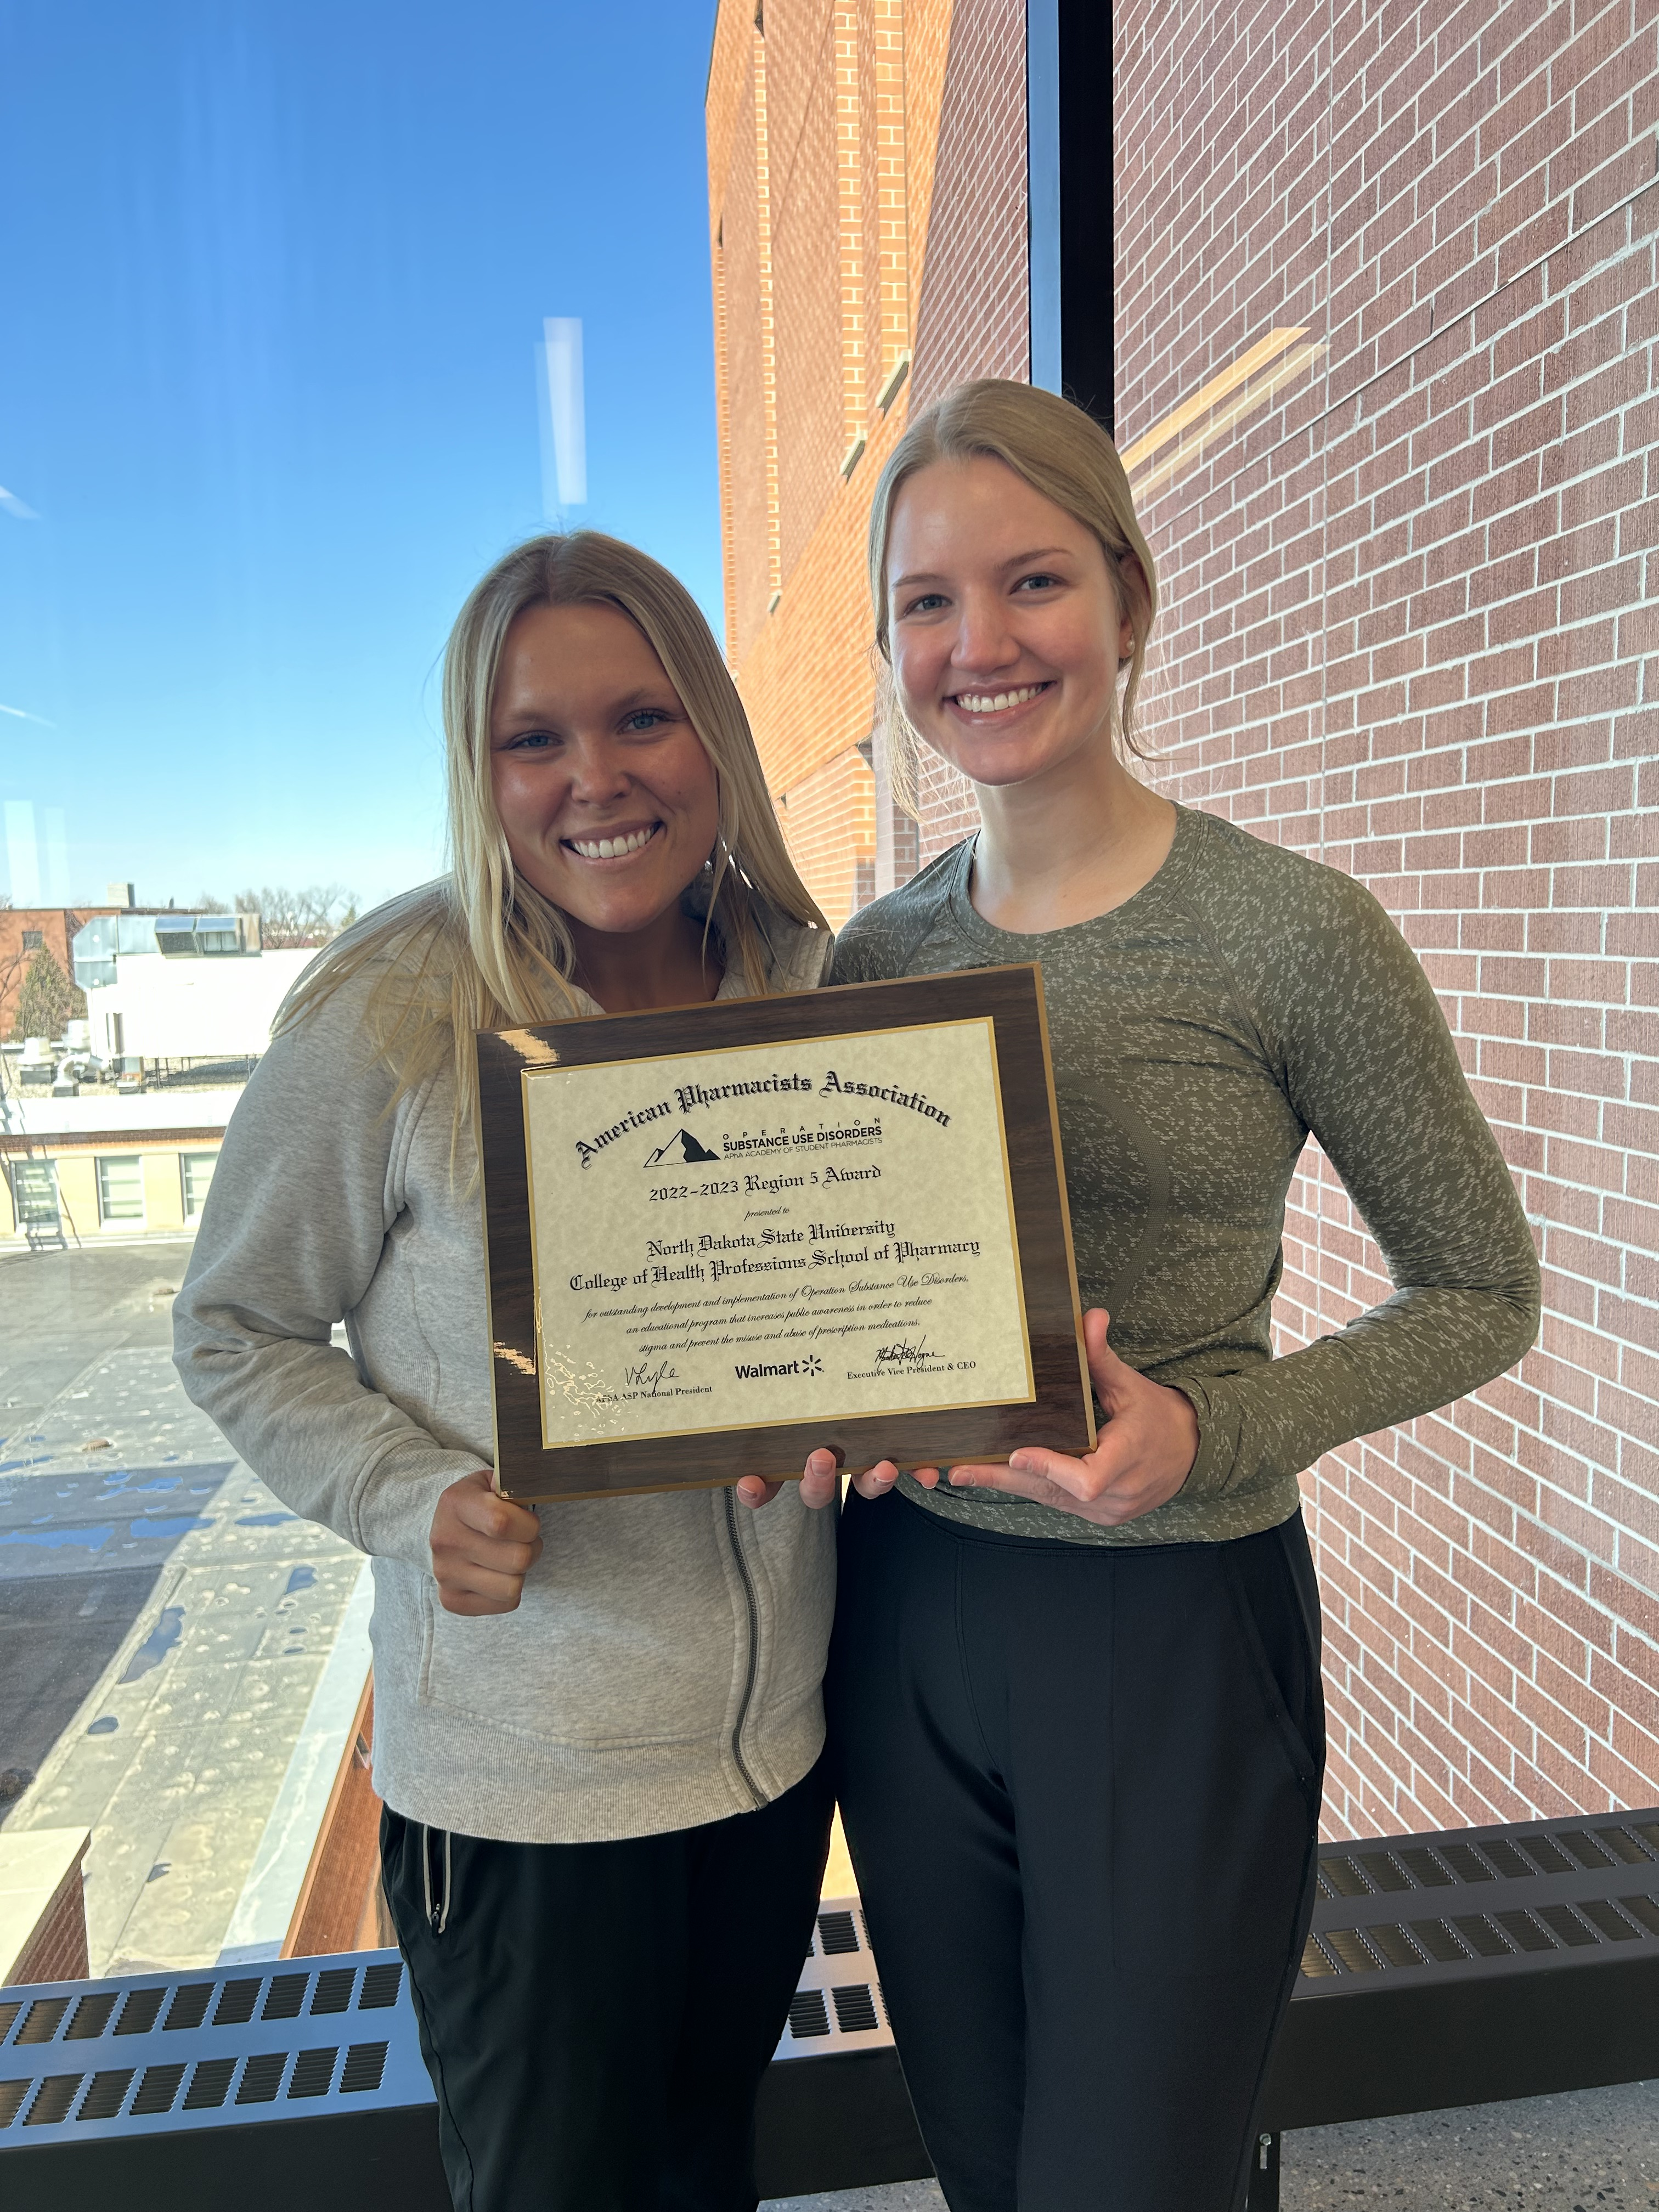
Midyear Regional Meeting
This year's Midyear Regional Meeting was virtual. 6 of our members gathered together to listen to updates from the region!
Other schools sent some of their members to attend the one big live meeting in Washington D.C.

Slide 10
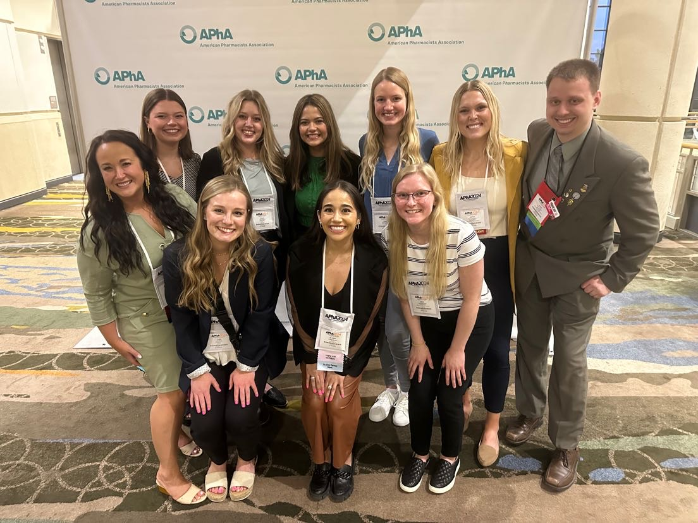
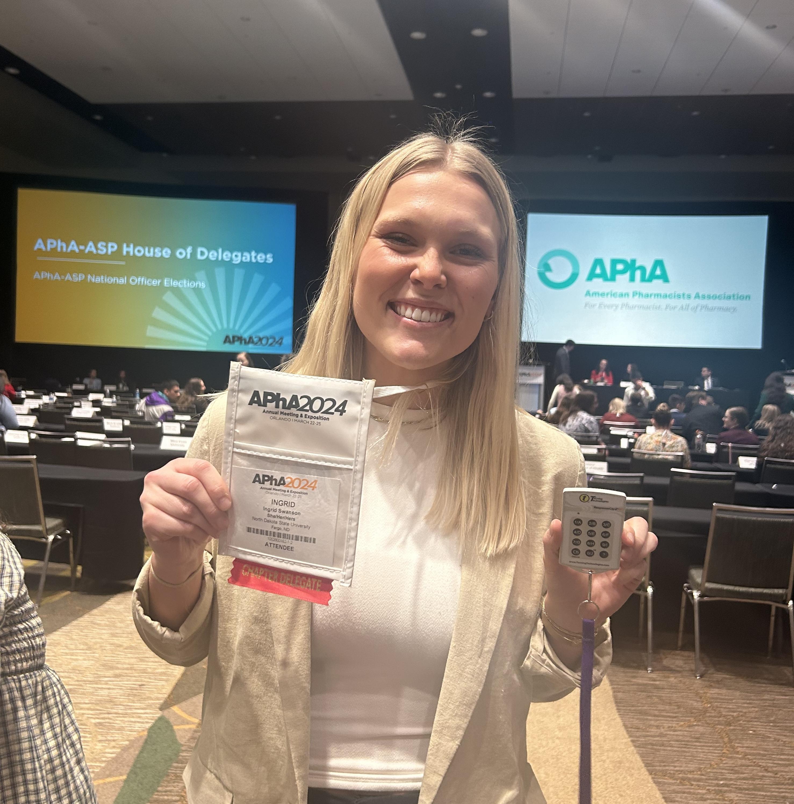
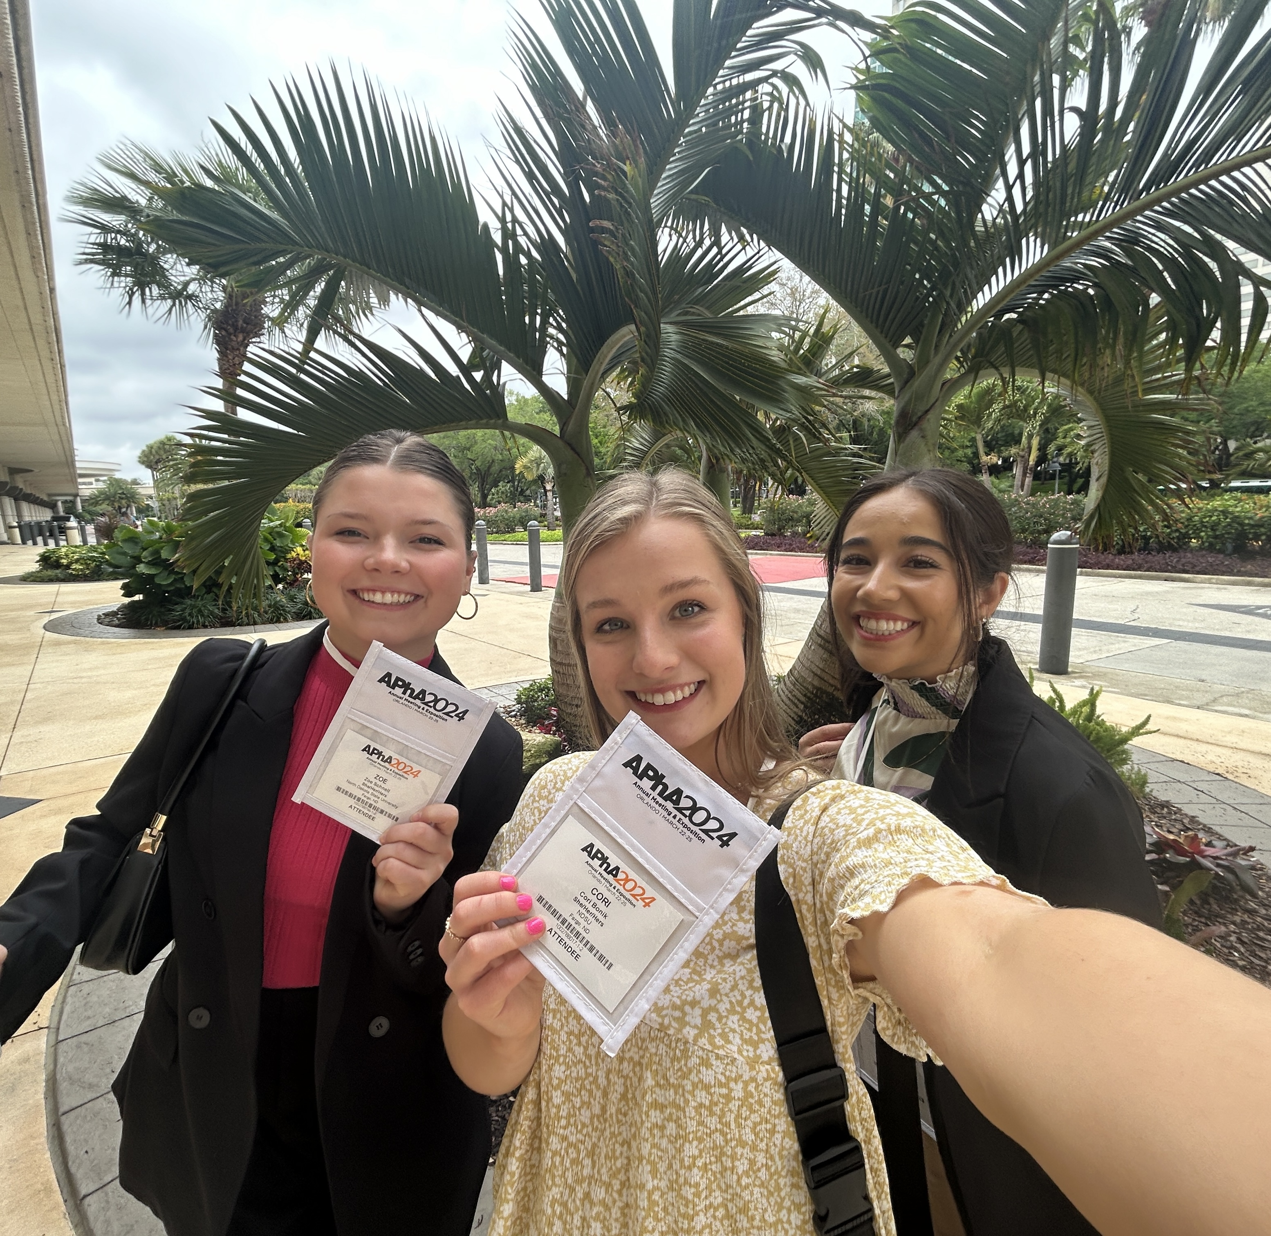
Annual Meeting
9 of our members were able to attend the APhA Annual meeting in Orlando, FL in March!
We learned so much and have many ideas for next year!​

Slide 11
Thank you!!

